Slide 1
Spotify Clone
Team Name: Dev Tech
Team No. : 21
Team Members and Roll No.
Devansh Aggarwal 2210990258
Devansh Bhagania 2210990259
Devansh Shandilya 2210990261
Devanshu Singh 2210990263
22CS016

Slide 2
Index
Objective
Introduction
Methodology, Approach & Techniques
Source Code (screenshots)
Result
Conclusion
Reference
22CS016

Slide 3
Objective
To create a Spotify Web clone using HTML/CSS
To use JavaScript to make the website functioning
To learn web development by recreating a popular website
To showcase and learn from this opportunity to make a project

Slide 4
Introduction
This project is a web music player, designed using HTML, CSS and JavaScript, and can play limited songs as visible on the home page playlists.
This web page enables listening to music by simply clicking the song to play, from different playlists as visible on the home page.

Slide 5
Methodology, Approach & Techniques
The framework for the web page was done using HTML, using div tags to create the card for the playlists, to make containers for the menu bar, to inscribe content at the head of the page, inscribing logos/icons, using other various tags to set the class, the play bar, the compiled songs list etc.
To manage the size and the placement of the containers as well as the background colors visible on the page, CSS was put to use, setting width, color, position, gaps, paddings and fonts of the content on the page.
Javascript was used to make the music player, that is, the algorithm to play music on one click, the audio files were uploaded in the project folder, javascript codes were used to access these files, and to handle the working of the player to play the song, or the next song, or the previous songs by using event functions which get triggered on click by the user.

Slide 6
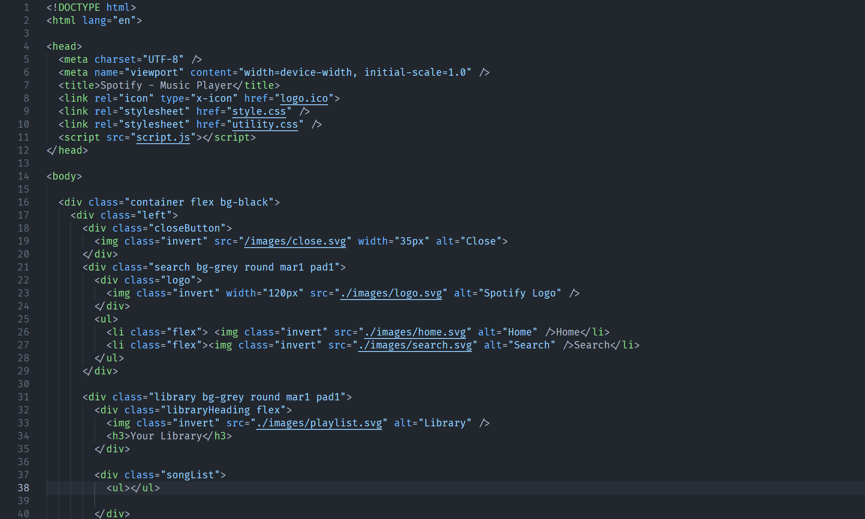
Source Code

Slide 7
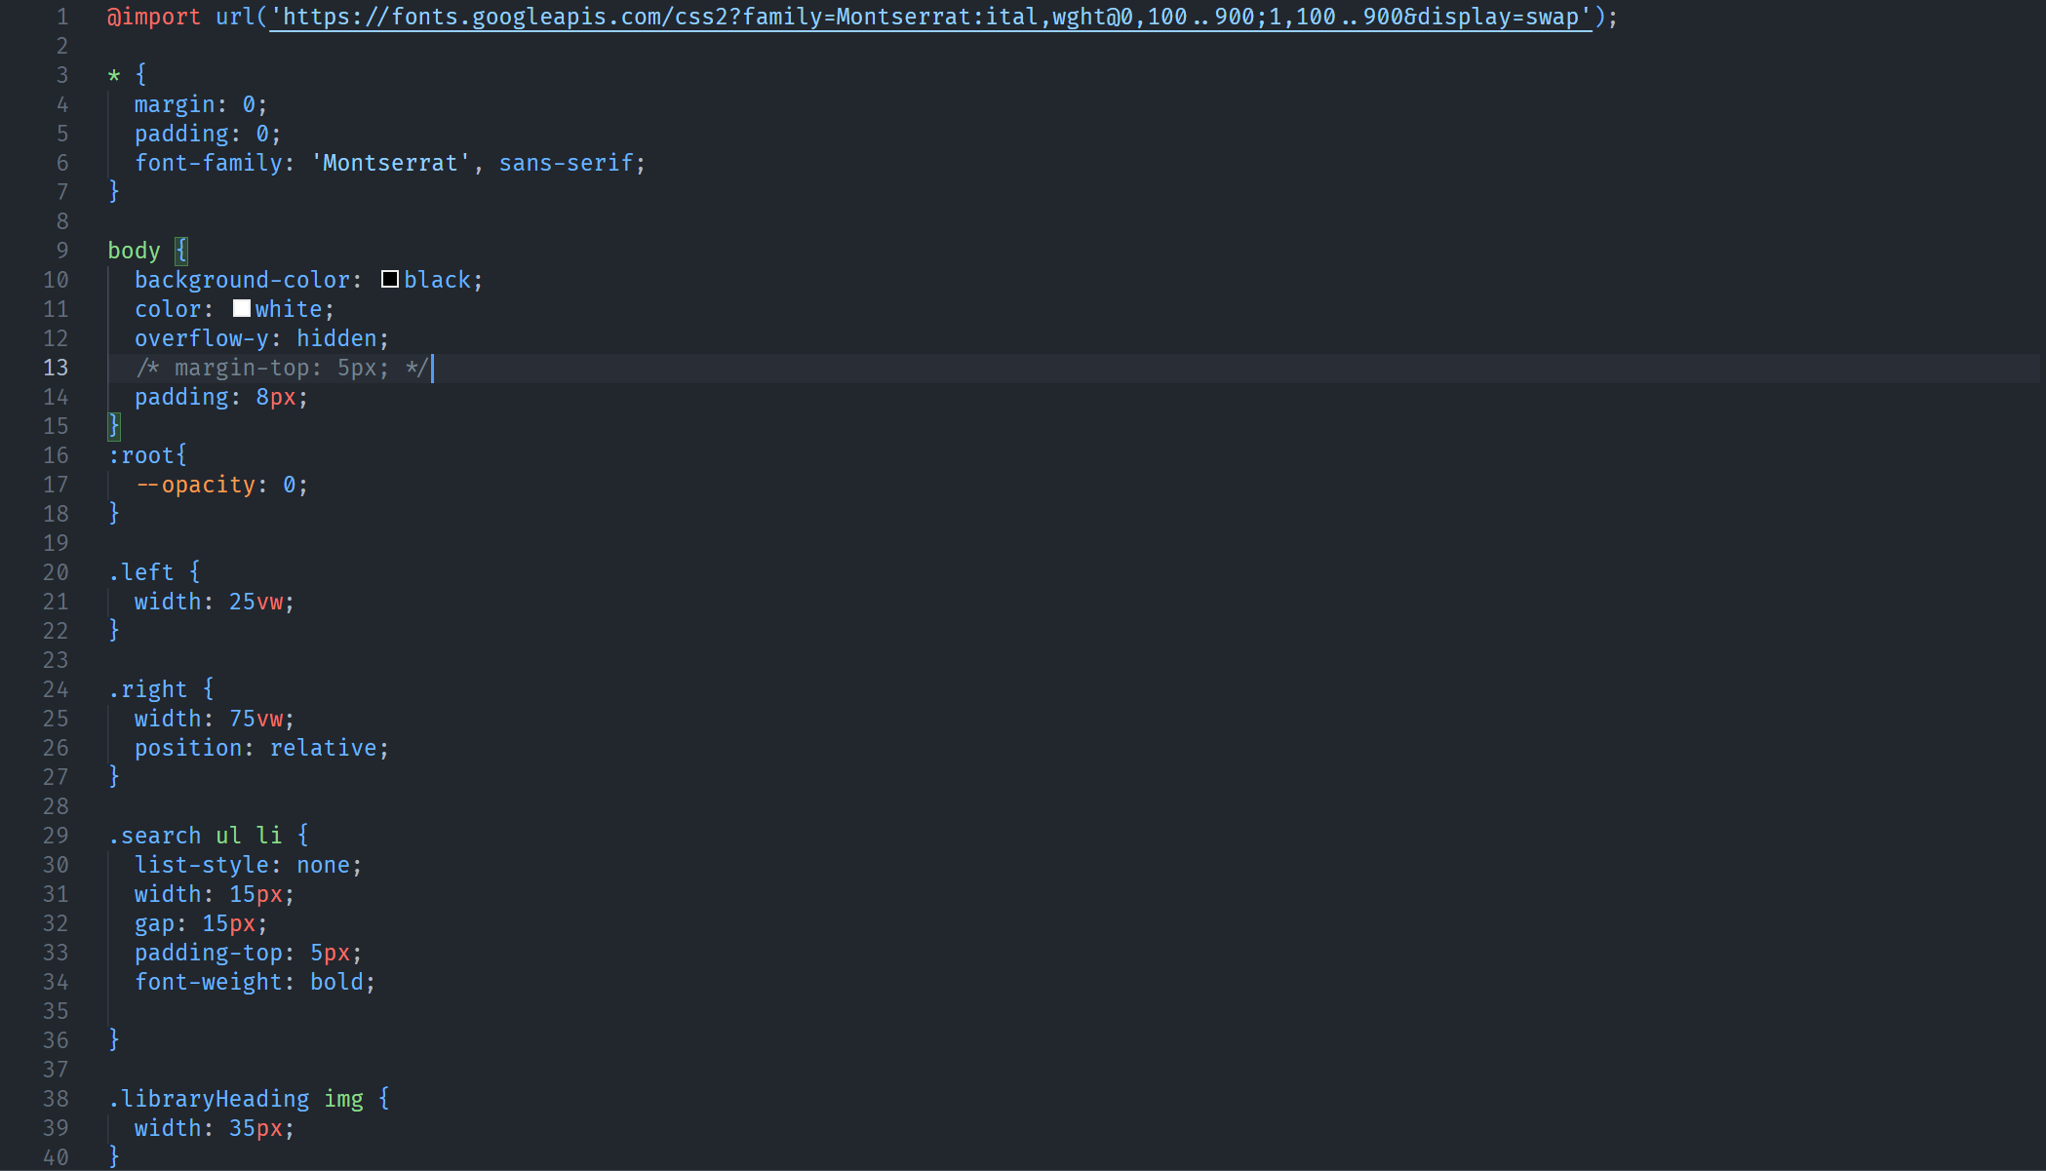
Source Code

Slide 8
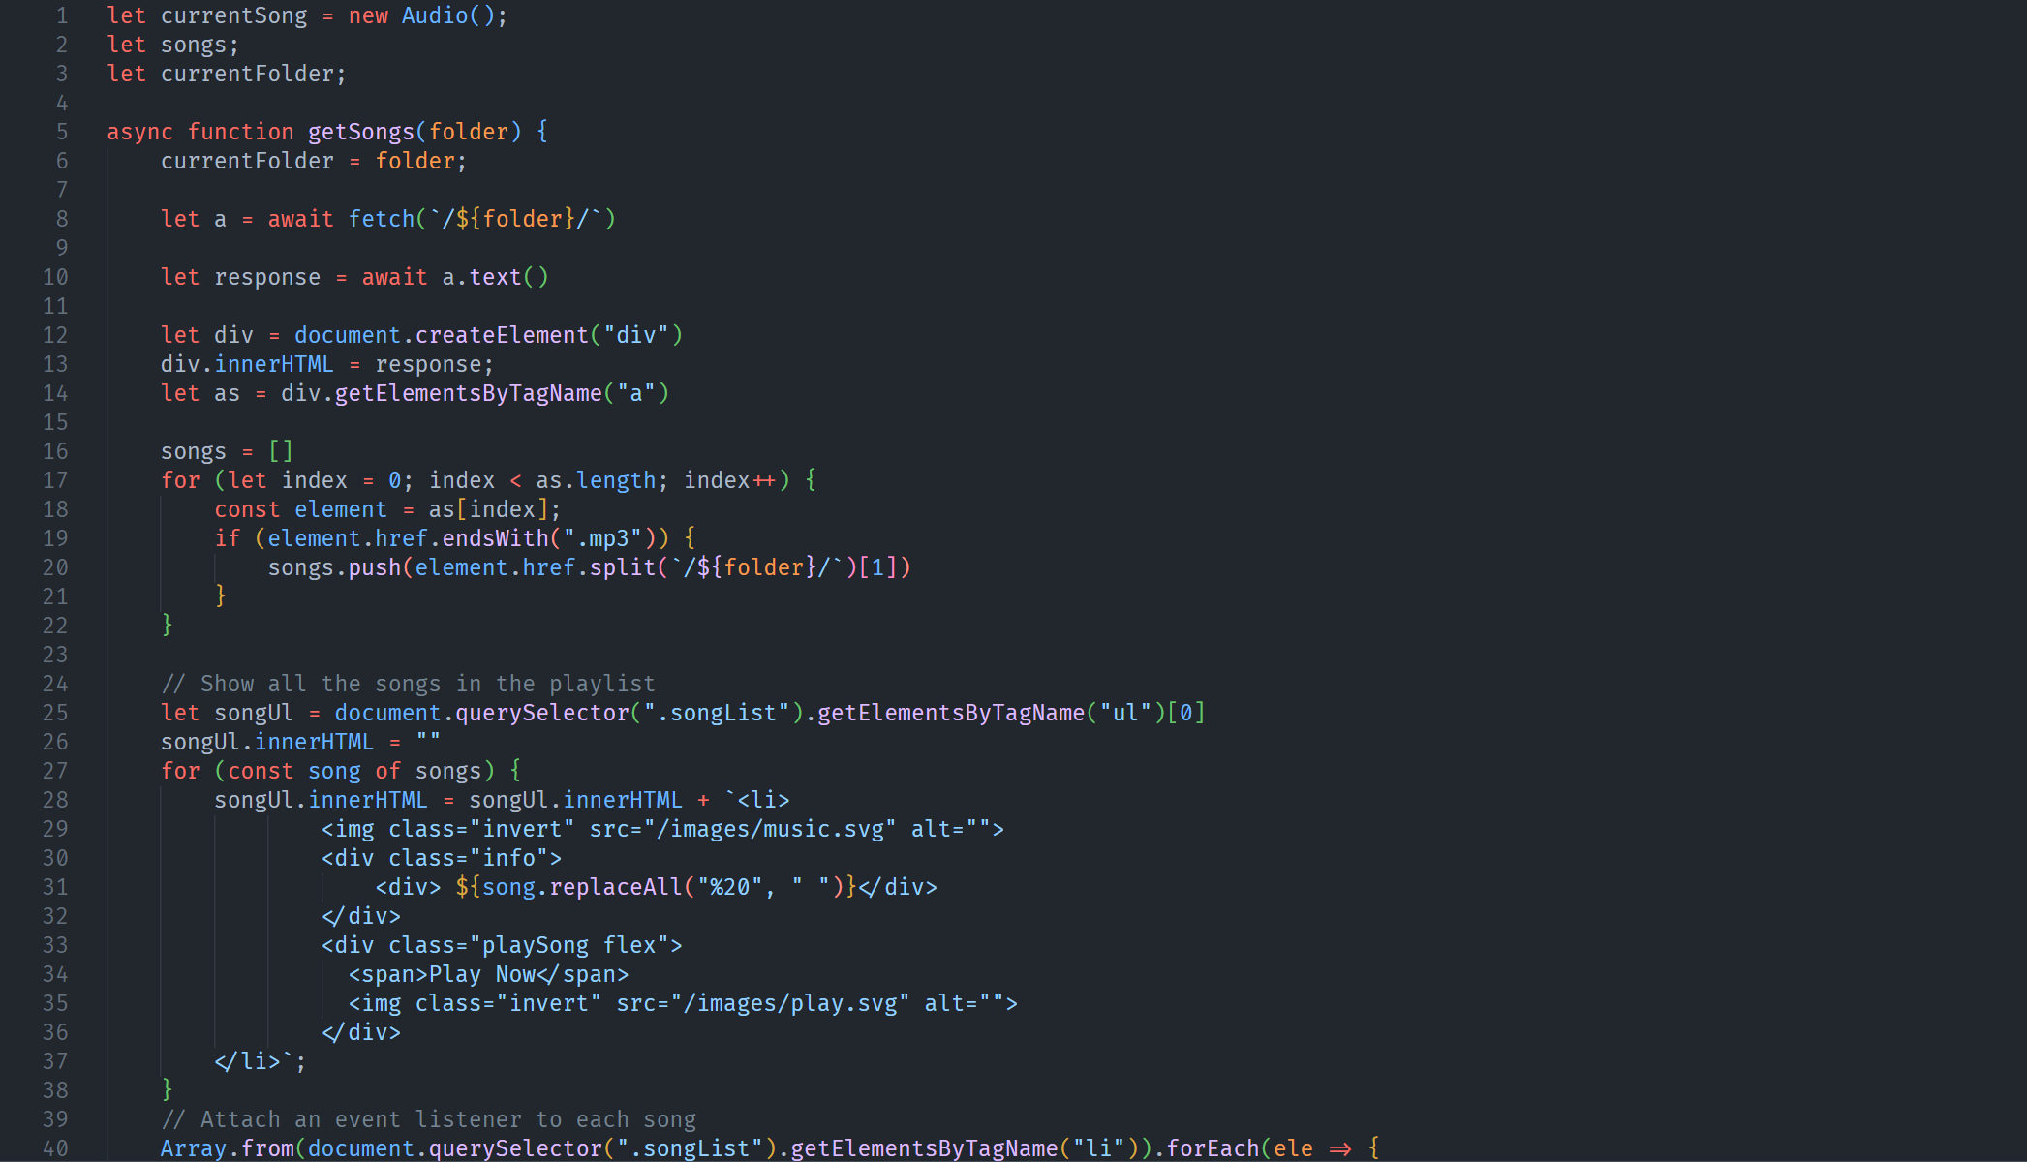
Source Code

Slide 9
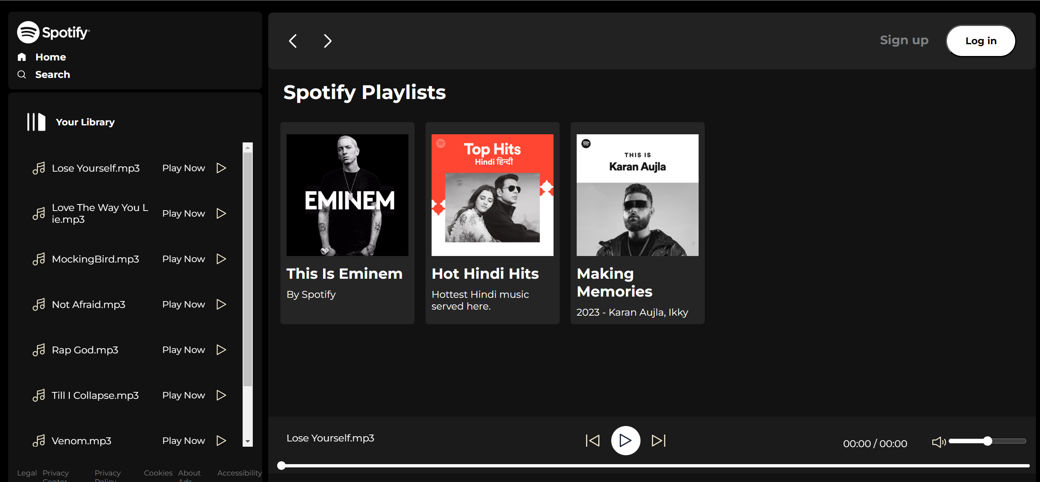
SCREENSHOTS(WEBSITE)

Slide 10
Conclusion
The music player successfully functions and works to play music on click and other functions work as needed.
We were able to learn, polish our skills, use Javascript, learn the functioning offered by Javascript to make a great web page.

Slide 11
Reference
1.) https://developer.mozilla.org/en-US/
2.) https://www.w3schools.com/
3.) https://open.spotify.com/
4.) https://www.wikipedia.org/
22CS016

Slide 12
End of Presentation.
22CS016

